Slide 1
Freshdesk Migration
Stakeholder Brief

Slide 2
Overview
Benefits
Objectives
Approach
Migration Plan

Slide 3

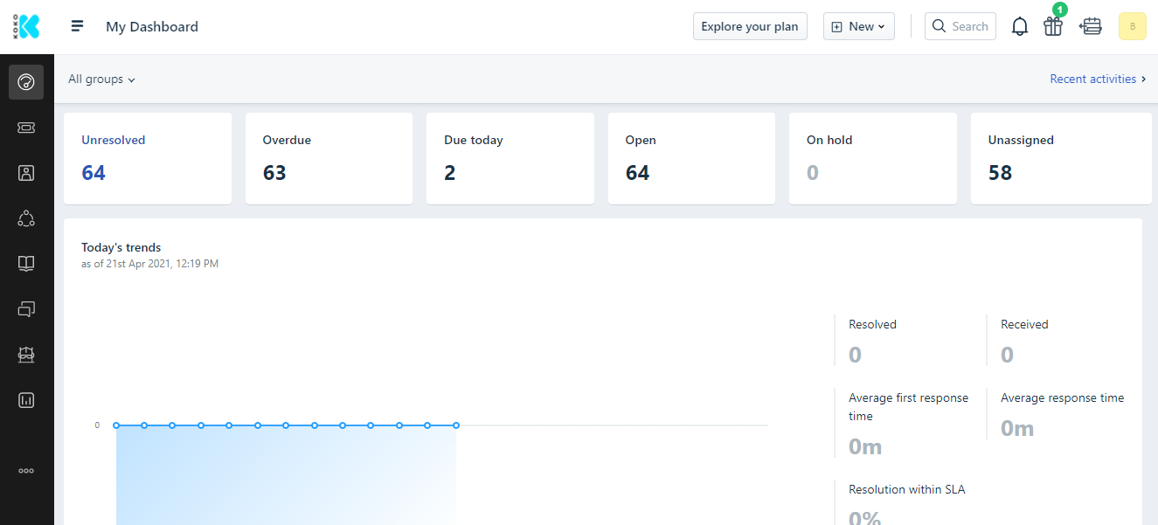
Freshdesk Overview
Freshdesk is a powerful cloud-based help desk solution with an easy to use user interface. It is functionally equivalent to to Zendesk, but is more user friendly. Freshdesk is a suitable replacement for Zendesk for the KOKO Customer Care team as a result of its merits compared to Zendesk.

Slide 4
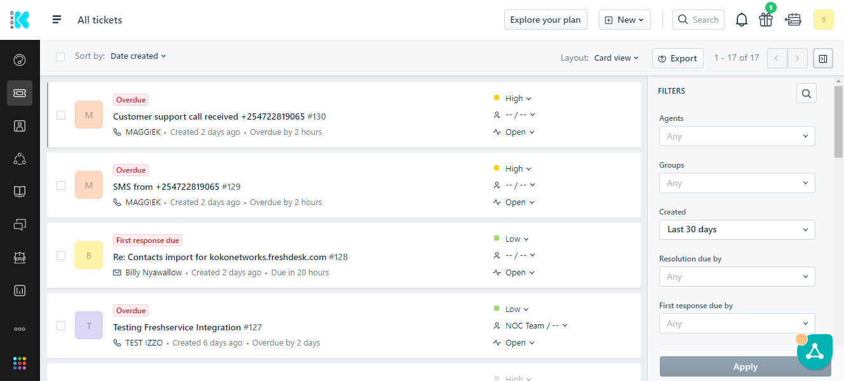
Freshdesk Views (Tickets)

Slide 5
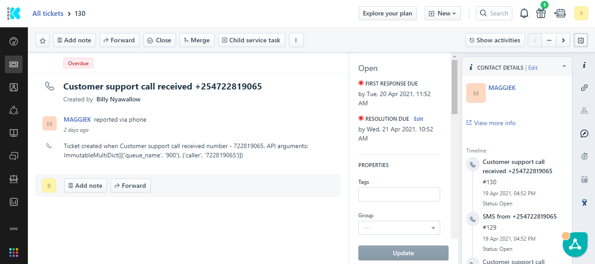
Freshdesk Views (Ticket Details)

Slide 6

Benefits Of Freshdesk
FEATURE | FRESHDESK | ZENDESK
Simple, user friendly UI/UX in Freshdesk will result in much simpler training requirements for Customer Care staff.
Native integration with WhatsApp will save on the cost of 3rd party integrations e.g $100+/month for Ongair.
Collaboration between CC, NOC and Engineering teams will been simplified, not requiring individual accounts in Jira or Freshservice.
Integrating with most external services such as Freshservice, Twitter, Facebook etc is much simpler and bi-directional and mostly don’t require 3rd party.
Comments and ticket support history in Freshdesk are hierarchically arranged and easy to view in a single timeline, simplifying ticket operations like merging.

Slide 7
Benefits Of Freshdesk
Price comparison between Freshdesk and Zendesk
FRESHDESK (ESTATE) | ZENDESK (SUITE TEAM)
Estate Plan (50 seats x $49*) | Support Professional Subscription (48 seats x $59)
Field Service Management (6 seats x $29*) | Support: Collaboration Subscription (48 seats x $25)
WhatsApp integration (1 unit x $49) | Ongair ($149)
Total cost (monthly): $2,673 | Total cost (monthly): $4,181
* after negotiated discount (~40%)

Slide 8
Migration Objectives
1 | Provide CCRs with improved tools for supporting new/returning KOKO customers
2 | Provide a robust integration with the WhatsApp customer support channel
3 | Automatically synchronize customer contacts between KOKO Core and Freshdesk.
4 | Better integration of CC with Network Operations (NOC) and Engineering
5 | Build reliable performance reports and dashboards for KOKO CC operations
6 | To ensure CC operations continue working effectively during and after migration is complete

Slide 9
Migration Scope
In scope:
Migrating the Customer Care WhatsApp support
Out of scope:
Migrating the Customer Care customer call support
Migrating the Customer Care customer SMS support

Slide 10
Migration Milestones
The proposed migration plan is intended to guide the preparation of Freshdesk for use by Customer Care (CC) and should be scheduled in agreement with Customer Care.
1 | Customer Care preparations (CC requirements)
2 | Freshdesk platform setup (platform configuration)
3 | Pre-migration preps (cleanup tasks)
4 | Migration of WhatsApp customer support
The detailed migration plan is available at this LINK.

Slide 11
Migration Approach
 | ITEM | DETAILS | STATUS
1. | Freshdesk preliminary testing & Zendesk comparison | Set up demo accounts Compare Freshdesk and Zendesk platform features | COMPLETE
2. | Freshdesk setup/configuration | Setup customer form fields Setup ticket form fields Setup automations in Freshdesk Setup triggers in Freshdesk Setup macros in Freshdesk Setup SLAs in Freshdesk Setup refined CC tags in Freshdesk | COMPLETE
3. | Freshdesk migration preparations | Conduct Freshdesk CC stakeholders brief Reset Freshdesk to remove test data Migrate all customer data from KC to Freshdesk Create CCR user accounts in Freshdesk Train CCRs in Freshdesk Set up daily & weekly Freshdesk reports | IN PROGRESS

Slide 12
Migration Approach
 | ITEM | DESCRIPTION | STATUS
4. | Freshdesk migration | Migrate the Zendesk WhatsApp channel to Freshdesk Setup monthly & quarterly reports in Freshdesk | NOT STARTED

Slide 13
Handling Historical Data
Historical data is defined as ticket data collected within the Zendesk platform and include, but is not limited to:
1 | Support tickets (Resolved/Active)
2 | CCRs (Inactive/Active)
3 | KOKO Customers (Registered/Unregistered)
Some causes of corrupted historical data:
1 | A huge number of tickets are orphaned (not linked to active CCRs)
2 | Many CCRs are no longer employees/active Zendesk users
3 | Several customers within Zendesk are not registered customers
4 | There are a lot of duplicate customer records (using different phone numbers)
In this scope, we’re not planning to migrate historical data.

Slide 14
Migration Schedule
PHASE | DELIVERABLES | DETAILS | CCRs | SCHEDULE
Phase 1 | WhatsApp channel migration | Disabling WhatsApp integration in Zendesk Linking the Freshdesk to KOKO production WhatsApp account. Set WhatsApp ticket volume to 100% | All TLs | TBD

Slide 15
Migration Resourcing
PHASE | CCRs | ASSIGNED CCRs
Phase 1 | All TLs | All TLs
*TLs to be tracked separately from the CCRs sheet.
Notes:
TL’s to be tracked separately from the agents sheet

Slide 16
Potential Next Steps (after migration)
After the Freshdesk migration, the following features could be implemented:
FEATURE | PRIORITY | NOTES
Migrate the call support channel | HIGH
Migrate the SMS support channel | HIGH
Cooker field visit scheduling within Freshdesk | HIGH
Deploy Field Service app to mobile CCRs | HIGH
Set up Freshdesk productivity automations | MEDIUM
Facebook integration | MEDIUM
Twitter integration | MEDIUM
WhatsApp chatbots | LOW
Embed FD widget into KOKO websites and myKOKO app | LOW

Slide 17
Supplementary Information
Handling Customer Data in Freshdesk
Customer Data From KOKO Core
Customer Care Ticket Fields In Freshdesk
NOC/Tech Reliability Ticket Fields In Freshdesk
Customer Care Reports & Dashboards

Slide 18
Handling Customer Data in Freshdesk
Users:
Registered customers (cooker owners)
Potential customers (leads)
KOKO Agents
Support scenarios:
Registered customer WhatsApp for themselves
Registered customer WhatsApp from a different number
Potential customer WhatsApp for themselves
Unregistered person (e.g. spouse) WhatsApp for registered customer
KOKO Agent WhatsApp for themselves
KOKO Agent WhatsApp for registered customer
KOKO Agent WhatsApp for potential customer
KOKO Core updating/creating customer profiles in Freshdesk
Notes:
Complete this with Sarah/Cynthia

Slide 19
Handling Customer Data in Freshdesk
Registered customer WhatsApp for themselves
Handling procedure:
Freshdesk creates a new support ticket and links it to the customer’s contact.
The CCR processes the new ticket using the registered customer’s contact.
Registered customer WhatsApp from a different number
Handling procedure:
Freshdesk creates a new customer contact based on the customer’s new phone number.
Freshdesk then creates a new support ticket and links it to this new customer contact.
The CCR creates a new child ticket linked to the registered customer’s contact.
The CCR resolves the child ticket, then closes the parent ticket manually.
Notes:
Complete this with Sarah/Cynthia

Slide 20
Handling Customer Data in Freshdesk
Potential customer WhatsApp for themselves
Handling procedure:
Freshdesk creates a new customer contact based on the potential customer’s phone number.
Freshdesk then creates a new support ticket and links it to this new customer contact.
The CCR processes the ticket using this new contact.
Unregistered person (e.g. spouse) WhatsApp for registered customer
Handling procedure:
Freshdesk creates a new customer contact based on the unregistered person’s phone number.
Freshdesk then creates a new support ticket and links it to this new customer contact.
The CCR creates a new child ticket linked to the registered customer’s contact.
The CCR resolves the child ticket, then closes the parent ticket manually.
Notes:
Complete this with Sarah/Cynthia

Slide 21
Handling Customer Data in Freshdesk
KOKO Agent WhatsApp for registered customer
Handling procedure:
Freshdesk creates a new support ticket and links it to the agent’s contact.
The CCR creates a new child ticket linked to the registered customer’s contact.
The CCR resolves the child ticket, then closes the parent ticket manually.
KOKO Agent WhatsApp for potential customer
Handling procedure:
Freshdesk creates a new support ticket and links it to the agent’s contact.
The CCR processes the ticket using the agent’s contact.
Notes:
Complete this with Sarah/Cynthia

Slide 22
Handling Customer Data in Freshdesk
KOKO Agent WhatsApp for themselves
Handling procedure:
Freshdesk creates a new support ticket and links it to the agent’s contact.
The CCR processes the new ticket according to SOPs.
KOKO Core updating/creating customer profiles in Freshdesk
Handling procedure:
KOKO Core compiles a list of customer contacts to be created/updated in FD.
KOKO Core searches for FD customer contacts by phone number.
If phone number matches, KC updates the customer contact in FD with KC details.
If phone number does not match, KC creates a new customer contact in FD.
Notes:
Complete this with Sarah/Cynthia

Slide 23
Customer Data From KOKO Core
The following data is migrated into Freshdesk from KOKO Core:
 | FIELD NAME | SAMPLE VALUES
1 | Unique External ID | 0000001
2 | Full Name | Firstname Lastname
3 | Phone Number | +254000000
4 | Customer Type | Household Kibanda Agent Nurse Agent-inactive Employee-other Employee-inactive Super-referrer Employee-csr
 | Link to KC | KC profile url

Slide 24
Customer Care Ticket Fields In Freshdesk
 | FIELD NAME | ORDER | REQUIRED?
1 | Search a requester | 1 | YES
2 | Group & Agent | 2 | YES
3 | Ticket Category | 3 | YES
4 | Type | 4 | YES
5 | Priority | 5 | YES
6 | Status | 6 | YES
7 | Subject | 7 | YES
8 | Description | 8 | YES
9 | Source (Channel) | 9 | YES
10 | Quality Assurance - Area of Improvement | 10 | YES
11 | CCR Extension | 11 | NO

Slide 25
NOC/Tech Reliability Ticket Fields In Freshdesk
 | FIELD NAME | ORDER | REQUIRED?
11 | Customer/Agent? | 11 | YES
12 | Who is affected (Calling)? | 12 | YES
13 | Company | 13 | NO
14 | KOKOPoint Affected | 14 | NO
15 | Issue Identified as | 15 | NO
16 | First troubleshoot done? | 16 | NO
17 | Second troubleshoot done? | 17 | NO
18 | Engineer investigating | 18 | NO
19 | Root Cause (Tech Reliability) | 19 | NO
20 | Call | 20 | NO

Slide 26
Customer Care Reports & Dashboards
 | REPORTS
1 | Weekly Ticket Performance
2 | Weekly Inbound Ticket Count by Issue Category
3 | Weekly Outbound Ticket Created by Issue Category
4 | Non-Cooker Tickets Pending > 1 Day
5 | Cooker Tickets Pending > 3 Days
6 | Tickets Created by Category Last 7 Days
7 | Weekly Sla Breached Tickets by Agent
8 | Daily Outbound Ticket Performance
9 | Weekly Report on CX/AX Unsolved Tickets
10 | Quarterly Top 10 Issue Categories CX/AX
11 | Quarterly SLA Breached Tickets by CC Agents
12 | Quarterly Agents Individual Tickets Performance
13 | Quarterly Team Performance on Ticket Status
14 | Quarterly CC Team Performance on Tickets.
15 | Quarterly Tickets Created by Channel
16 | Daily Top Ticket Categories - Non-Call
17 | Historical Backlog
18 | Monthly Unsolved Tickets - Calls & Tickets (CX/AX)
19 | Monthly Tickets
 | DASHBOARDS
1 | Daily Ticket Report
2 | Weekly Reports - CC Team
3 | Monthly Reports - CC Team
4 | Quarterly Report - CX/AX Team

Slide 27
k.nyawallow@kokonetworks.com
d.meredith@kokonetworks.com

